Slide 1

Ganpat University CP- 1 FACILITY Management
Presented By :-
❖ Khorasiya Abhishek ( 20012021011 )
❖ Lakhani Dhruv ( 20012011055 )
❖ Trivedi Alig (20012011174)
Guided By :- Prof. Yogesh Prajapati ( 7984011603 )

Slide 2




We visited all these websites to learn
But apart from Urban company and k:kandua, all the websites had bad homepages

Slide 3
Home page bar options
Our homepage bar will have these options
Home
Service
Blog
Contact us
Search bar

Slide 4
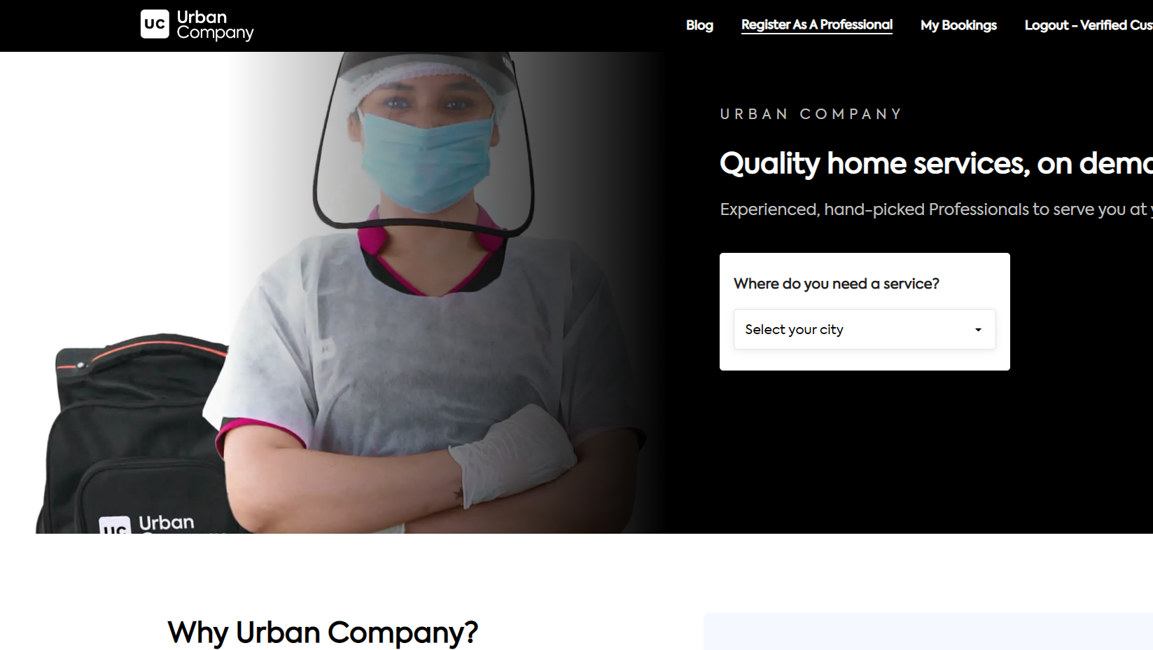
Our page will not be like direct copy to copy urban company, this is just for idea

Slide 5


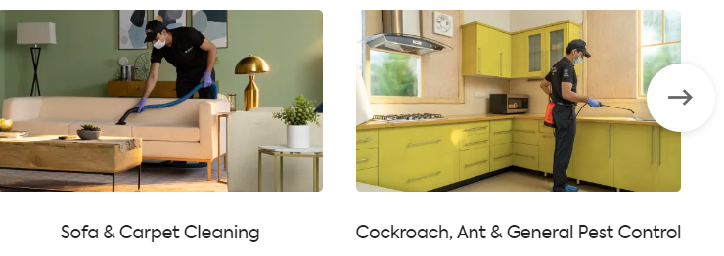
The service options that we are going to provide will be as follows

Slide 6



In our website we will provide the services of
Plumbers, Carpenters, Electrician. It will look Something like in our website.

Slide 7

Thank you
If you have any suggestion
Please give it to us.

